Slide 1
Snack Squad: A Customizable Snack Ordering And Delivery App

Slide 2
DESCRIPTION
Snack Squad is a customizable snack ordering and delivery app. Here are some ideas for features you could include in a snack ordering app: Healthy options: Include healthy snack choices and allergen filters Reorder options: Allow users to save their favorite snacks for reordering Rewards account: Let users earn and redeem points for purchases Dark color scheme: Use a dark color scheme so it’s easy to use in a movie theater Special requests: Include an area for users to make special requests Counter options: List the same options available at the counter Some other snack ordering apps include: MoviEats, SNACKIES, Snackatory, PipocaCinema, Happy Bite, Flixer, and Snackr.

Slide 3
Source code:
Package com.example.snackordering import android.icu.text.SimpleDateFormat import android.os.Bundle import android.util.Log import androidx.activity.ComponentActivity import androidx.activity.compose.setContent import androidx.compose.foundation.Image import androidx.compose.foundation.layout.* import androidx.compose.foundation.lazy.LazyColumn import androidx.compose.foundation.lazy.LazyRow import androidx.compose.foundation.lazy.items import androidx.compose.material.MaterialTheme import androidx.compose.material.Surface import androidx.compose.material.Text import androidx.compose.runtime.Composable import androidx.compose.ui.Modifier

Slide 4
import androidx.compose.ui.graphics.Color import androidx.compose.ui.layout.ContentScale import androidx.compose.ui.res.painterResource import androidx.compose.ui.unit.dp import androidx.compose.ui.unit.sp import com.example.snackordering.ui.theme.SnackOrderingTheme import java.util.* class AdminActivity : ComponentActivity() { private lateinit var orderDatabaseHelper: OrderDatabaseHelper override fun onCreate(savedInstanceState: Bundle?) { super.onCreate(savedInstanceState) orderDatabaseHelper = OrderDatabaseHelper(this) setContent { SnackOrderingTheme { // A surface container using the ‘background’ color from the theme Surface( modifier = Modifier.fillMaxSize(), color = MaterialTheme.colors.background ) { val data=orderDatabaseHelper.getAllOrders(); Log.d(“swathi” ,data.toString()) val order = orderDatabaseHelper.getAllOrders()

Slide 5
ListListScopeSample(order) } } } } } @Composable fun ListListScopeSample(order: List<Order>) { Image( painterResource(id = R.drawable.order), contentDescription = “”, alpha =0.5F, contentScale = ContentScale.FillHeight) Text(text = “Order Tracking”, modifier = Modifier.padding(top = 24.dp, start = 106.dp, bottom = 24.dp ), color = Color.White, fontSize = 30.sp) Spacer(modifier = Modifier.height(30.dp)) LazyRow( modifier = Modifier .fillMaxSize() .padding(top = 80.dp), horizontalArrangement = Arrangement.SpaceBetween ){

Slide 6
item { LazyColumn { items(order) { order -> Column(modifier = Modifier.padding(top = 16.dp, start = 48.dp, bottom = 20.dp)) { Text(“Quantity: ${order.quantity}”) Text(“Address: ${order.address}”) } } } } } }

Slide 7
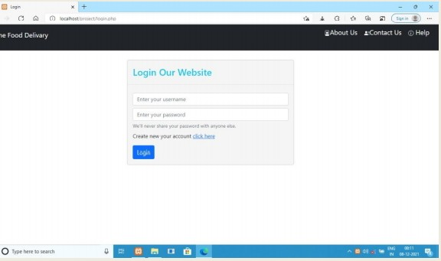
OUTPUT:

Slide 8
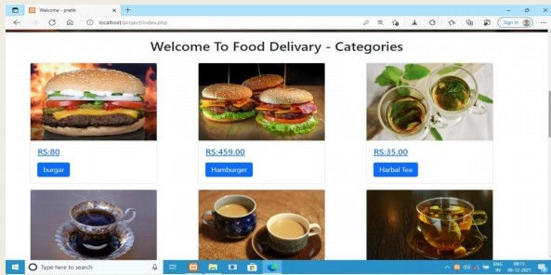

Slide 9
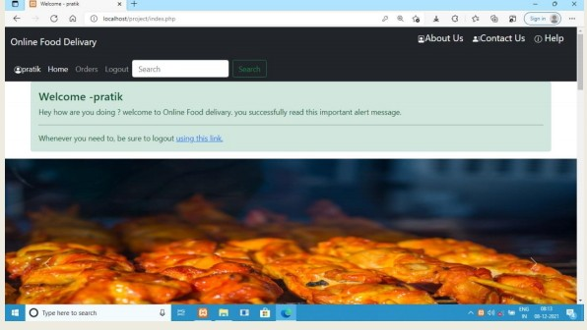

Slide 10
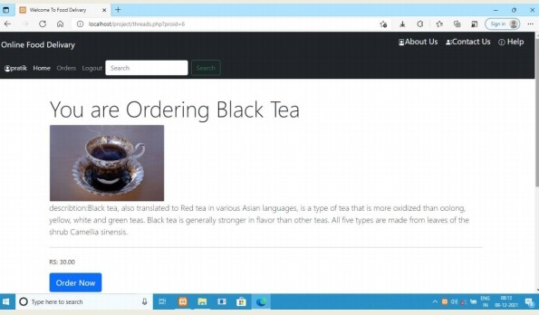

Slide 11
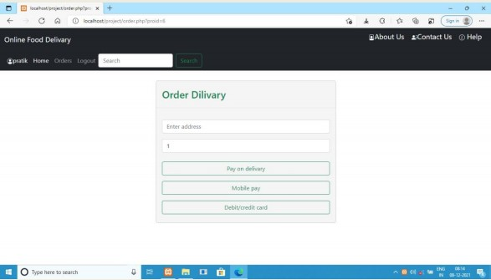

Slide 12
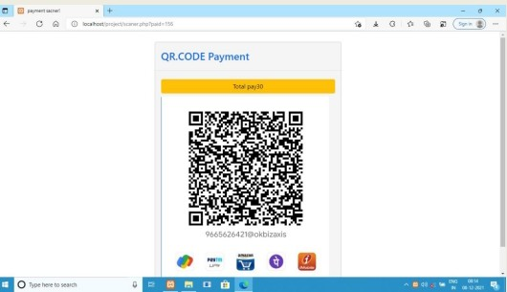

Slide 13
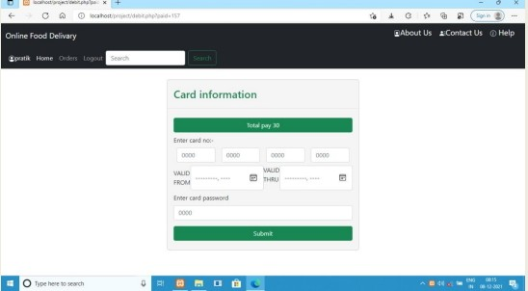

Slide 14
